Slide 1
How Computer Networks Work
Introduction

Slide 2
Network Classifications
Local area network (LAN)—Example: Computers in an office
Metropolitan area network (MAN)—Example: University or city
Wide area network (WAN)—Example: Company with offices around the world

Slide 3
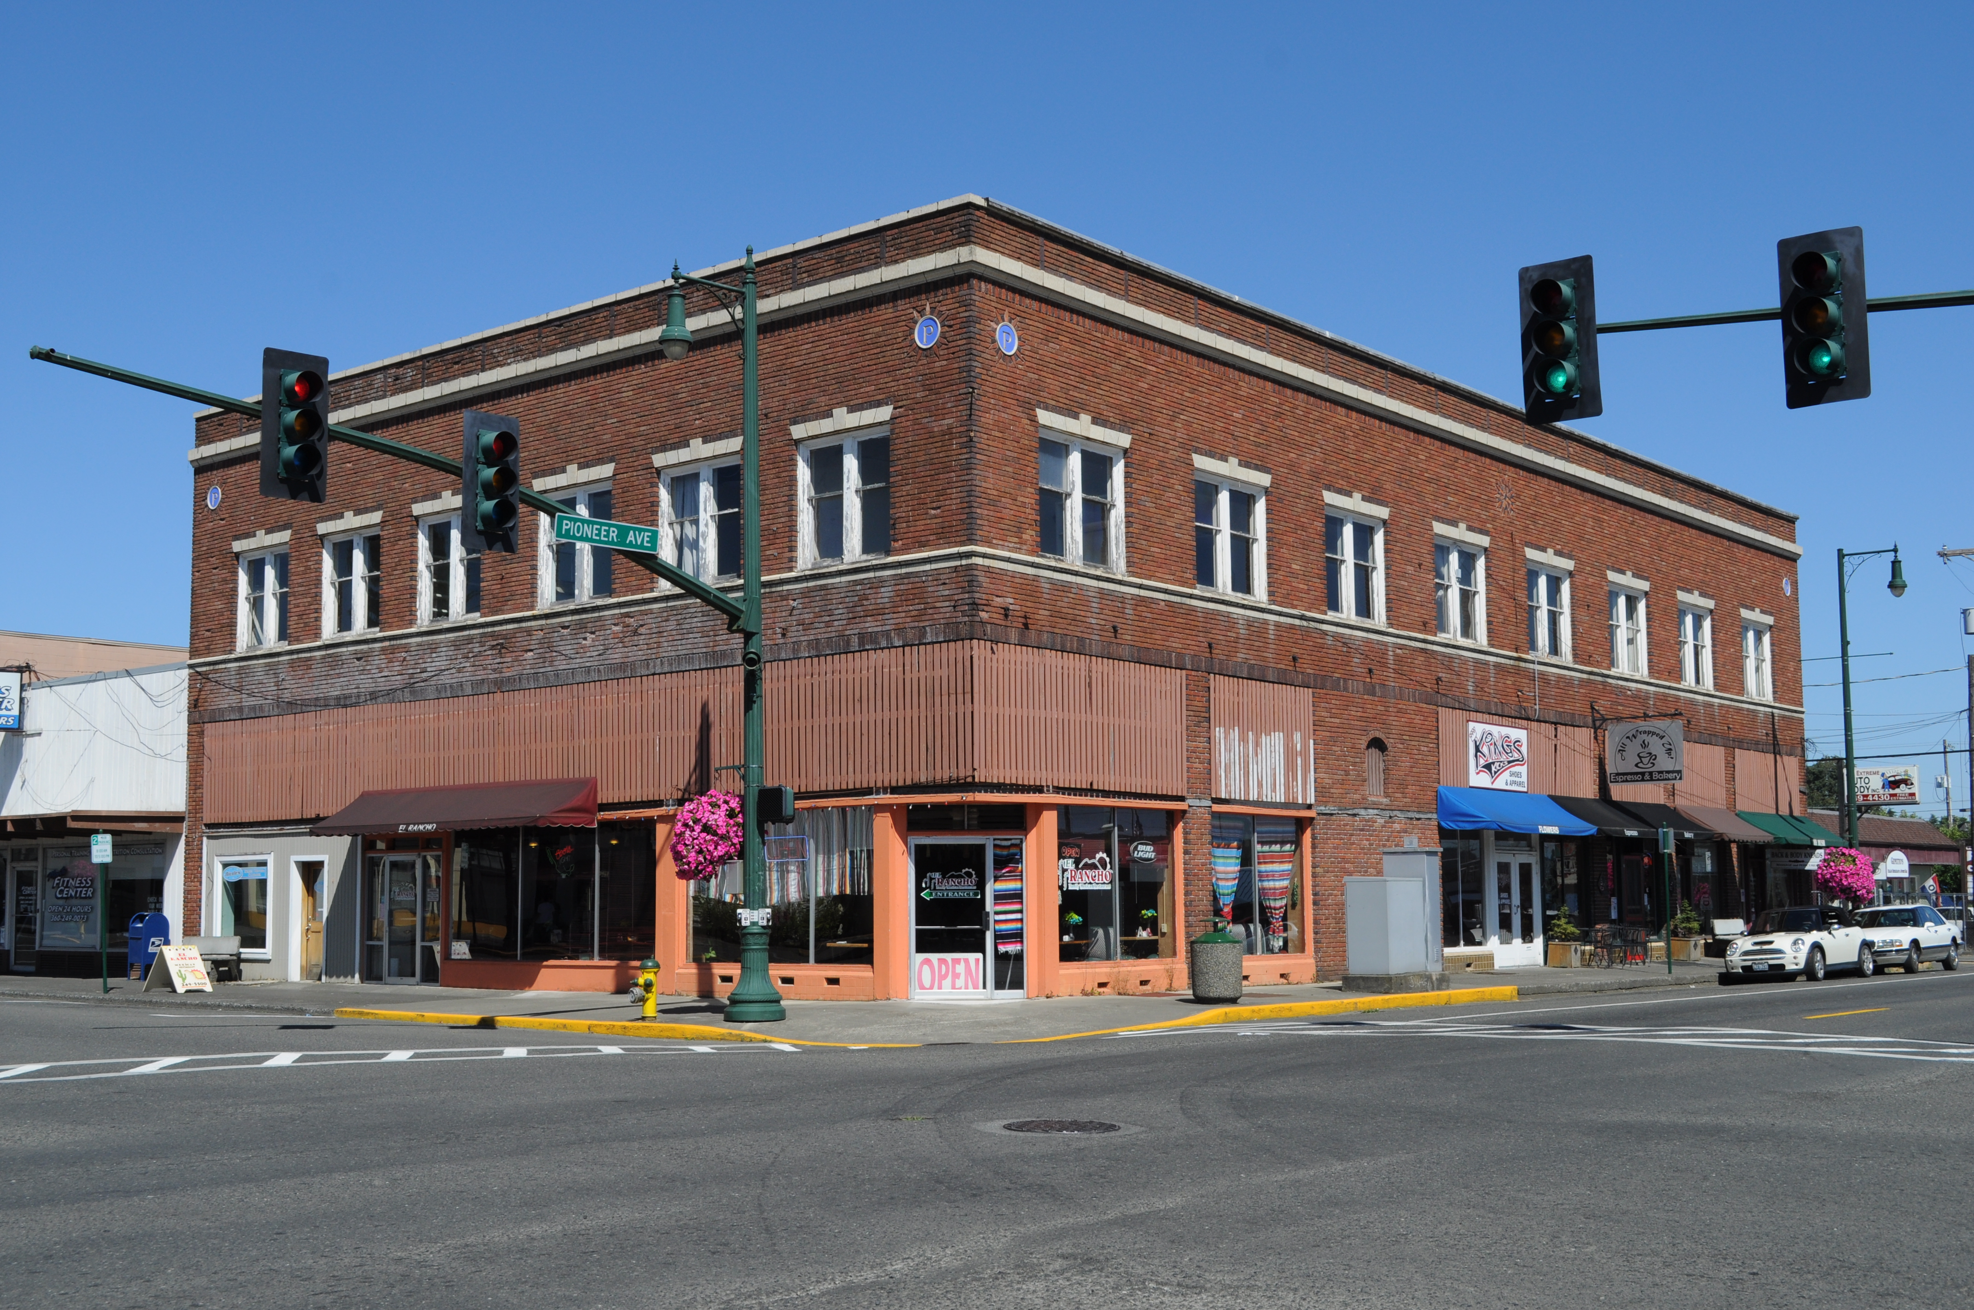
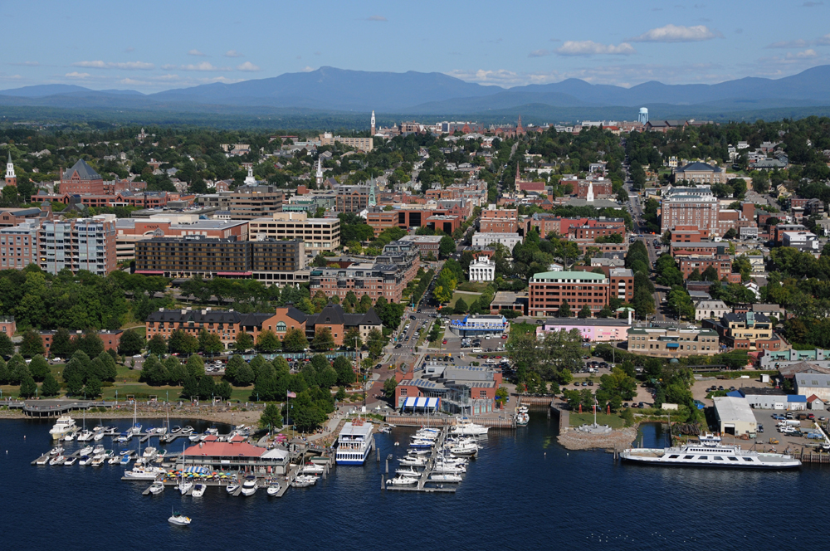
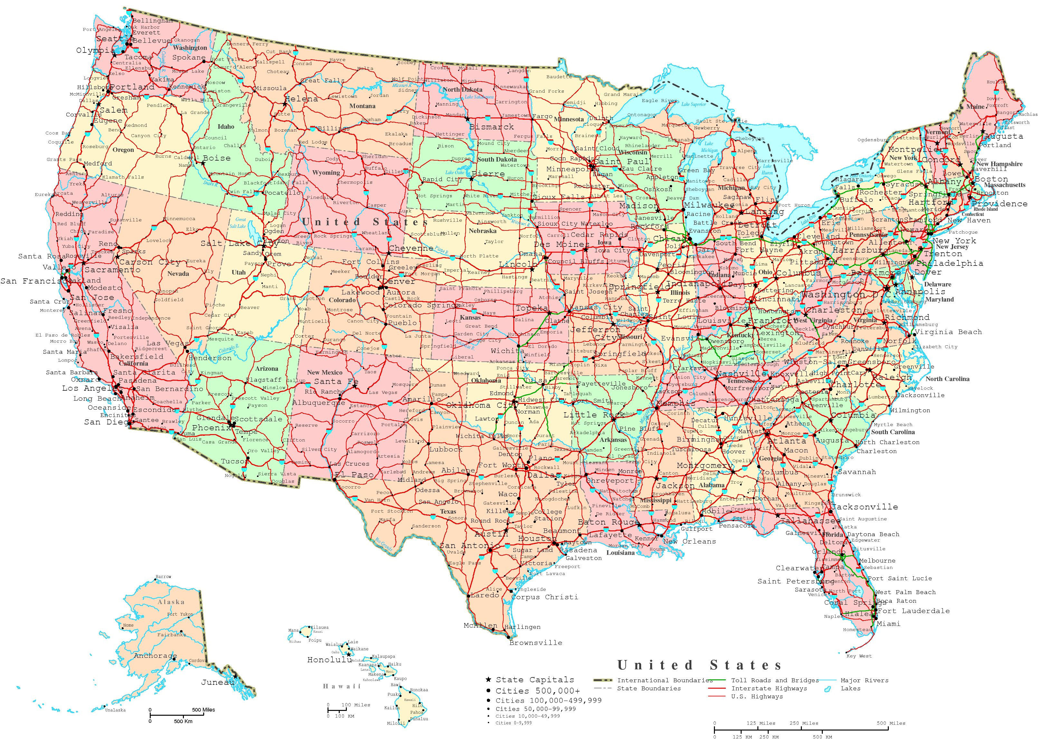
Network Classification
LAN
MAN
WAN

Slide 4
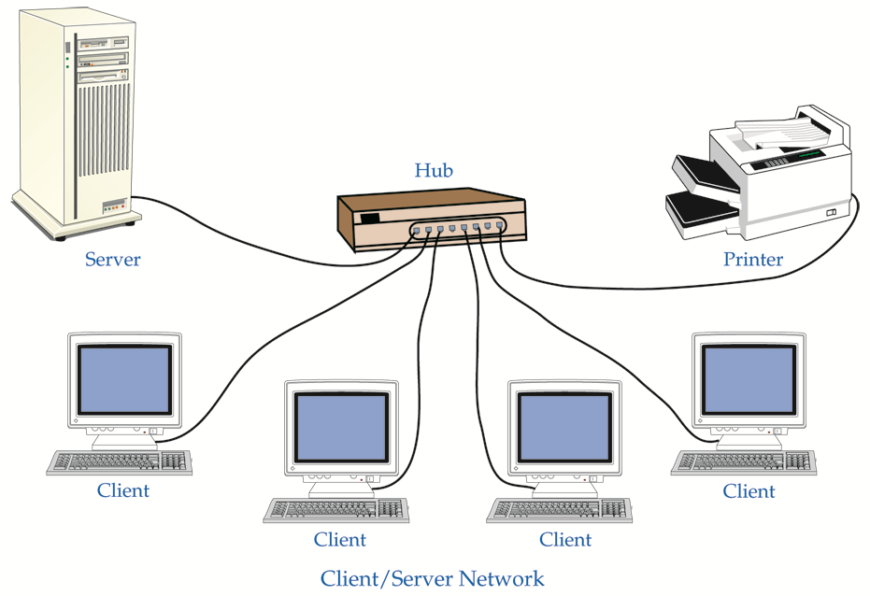
Client/Server Network
A Server provides client services such as security, data storage, Internet access, and email

Slide 5
How Networks Work
How a Modem Works

Slide 6
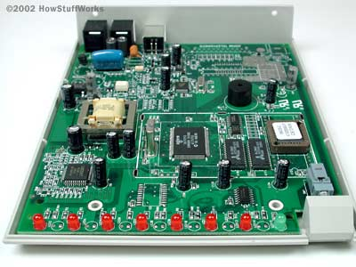

56k Modem

Slide 7
Tone Generation
When a terminal's modem dials a computer's modem, the terminal's modem is called the originate modem. It transmits a 1,070-hertz tone for a 0 and a 1,270-hertz tone for a 1.
The computer's modem is called the answer modem, and it transmits a 2,025-hertz tone for a 0 and a 2,225-hertz tone for a 1.

Slide 8
Modem Speeds
300 bps (bits per second) - 1960s through 1983
1200 bps - Gained popularity in 1984 and 1985
2400 bps
9600 bps - First appeared in late 1990 and early 1991
19.2 kilobits per second (Kbps)
28.8 Kbps
33.6 Kbps
56 Kbps - Became the standard in 1998
DSL, with theoretical maximum of up to 8 megabits per second (Mbps) - Gained popularity in 1999

Slide 9
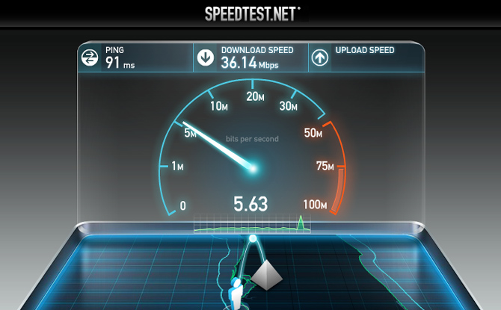
Check your Speed
http://www.speedtest.net

Slide 10
How Networks Work
How Terminals Work

Slide 11
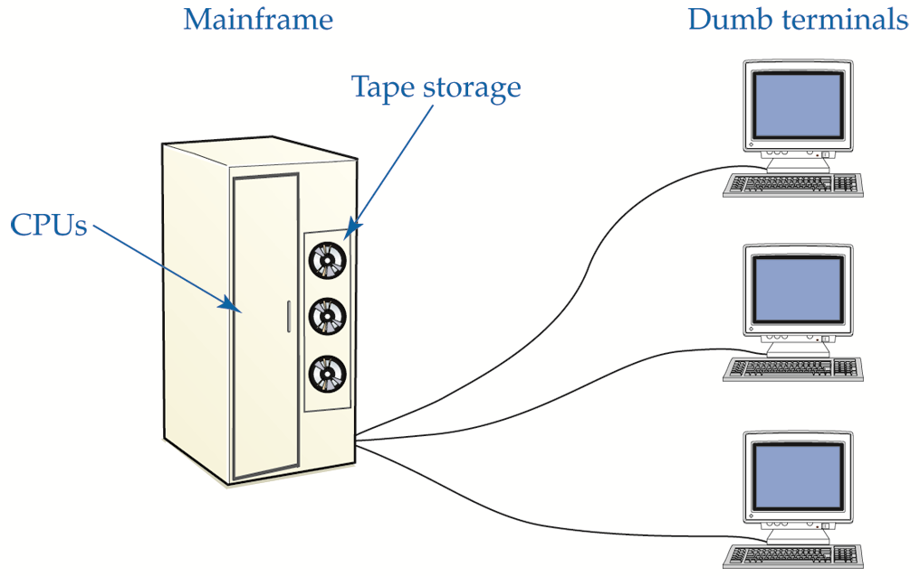
Terminal / Mainframe

Slide 12
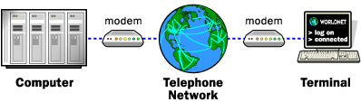
Terminal PC
Terminals “Dial in” to a large, central computer

Slide 13
How Networks Work
The PC as a Terminal

Slide 14
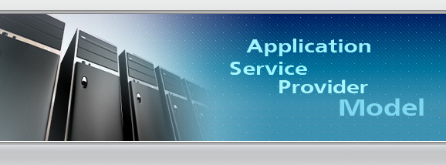
ASP Model

Slide 15
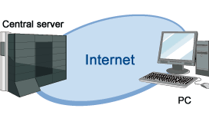
Infrastructure as a Service

Slide 16
How Networks Work
How Networking Operating Systems Work

Slide 17
Network Operating System (NOS)
Provides communication between different operating systems
Windows Server
Linux
UNIX

Slide 18
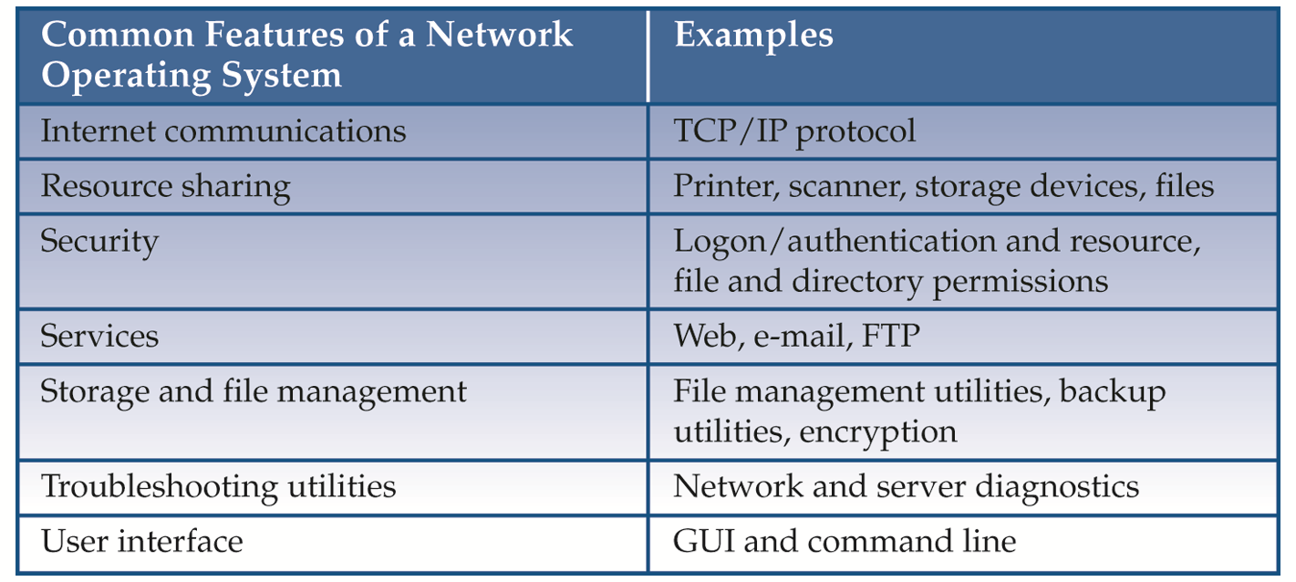
Common Operating System Traits

Slide 19
How Networks Work
How Network Interface Cards Work

Slide 20
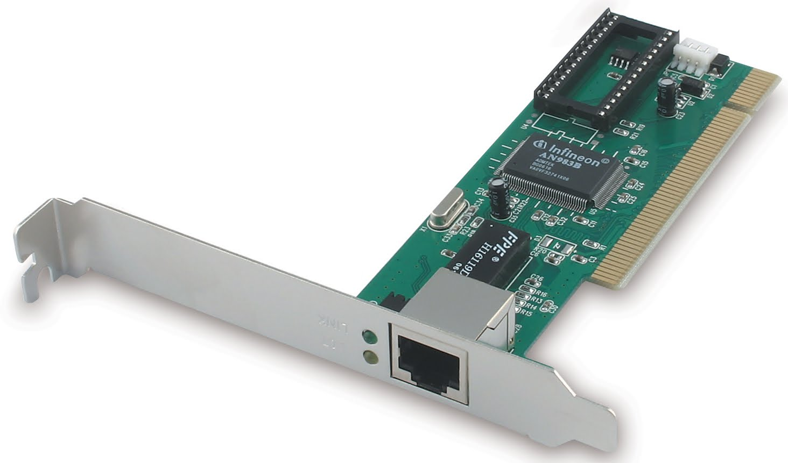
Network Interface Card (NIC)

Slide 21
Network Interface Card (NIC)
Must match physical communication requirements of the network
Requires driver to communicate with other computer hardware
Contains unique identifiers:
Physical: MAC (media access control) address
Logical identification: Computer name

Slide 22
How Networks Work
How Network Cables Work

Slide 23
Media Types
Copper core cable—Most common media; plastic or synthetic insulation
Network Cables—Cat5/5e, Cat6 Twisted pair
Fiber-optic cable—Has glass or plastic core
Radio waves—Carries signals in wireless networks
Infrared light—Beam used to transport digital signal

Slide 24
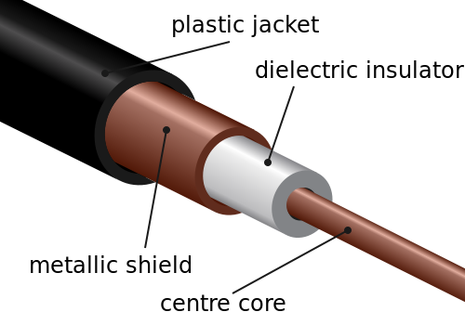
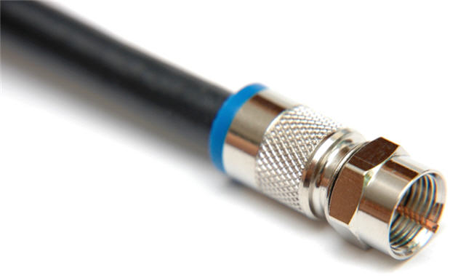
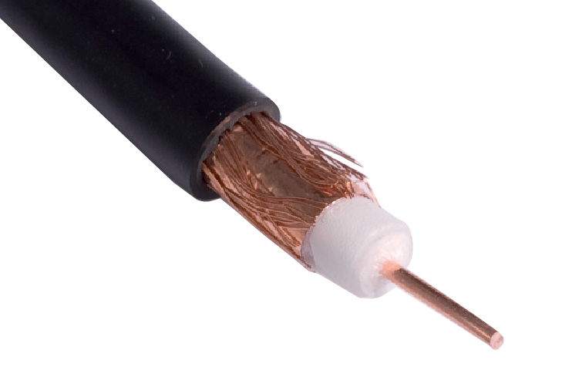
Coaxial Cable
Common Types: RG – 59, RG – 6
Number of Shields can be Single, Double, etc.

Slide 25
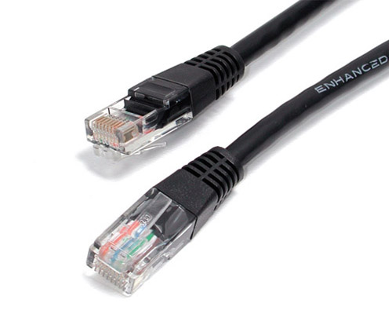
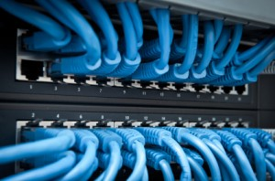
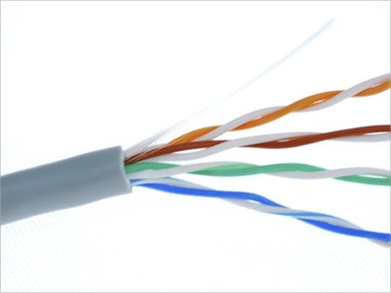
Network Cable
Category 5e (Cat 5e) standardized
cable for Ethernet

Slide 26
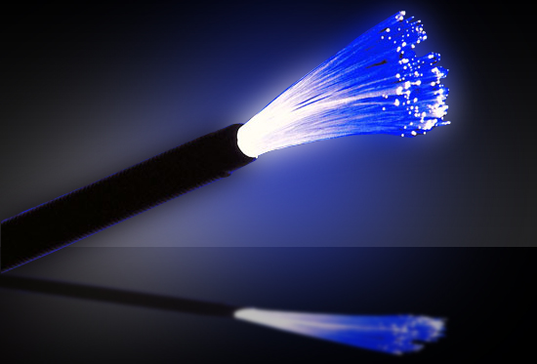
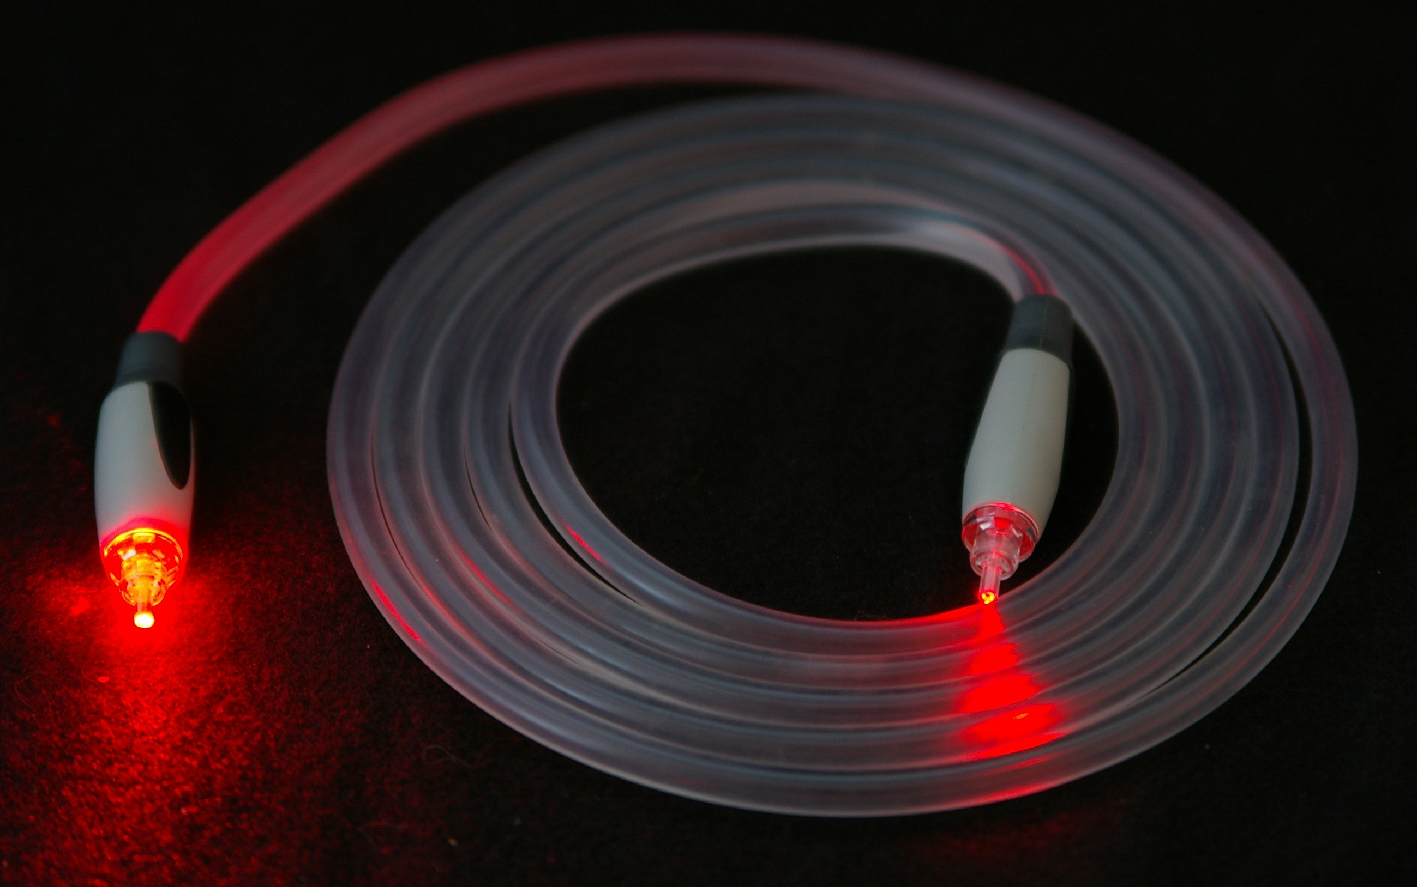
Fiber Optic

Slide 27
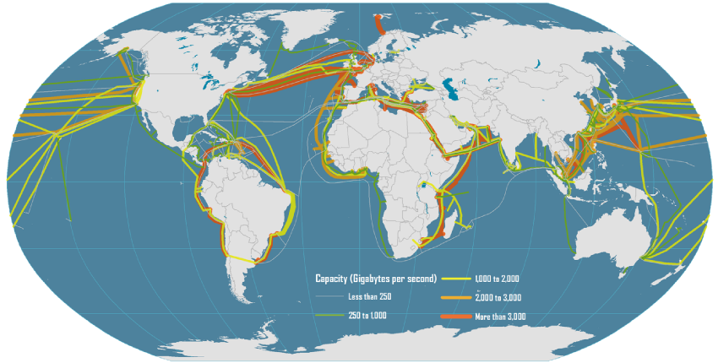
Transcontinental “Submarine” Network Cables

Slide 28
How Networks Work
How Wireless Networks Work

Slide 29
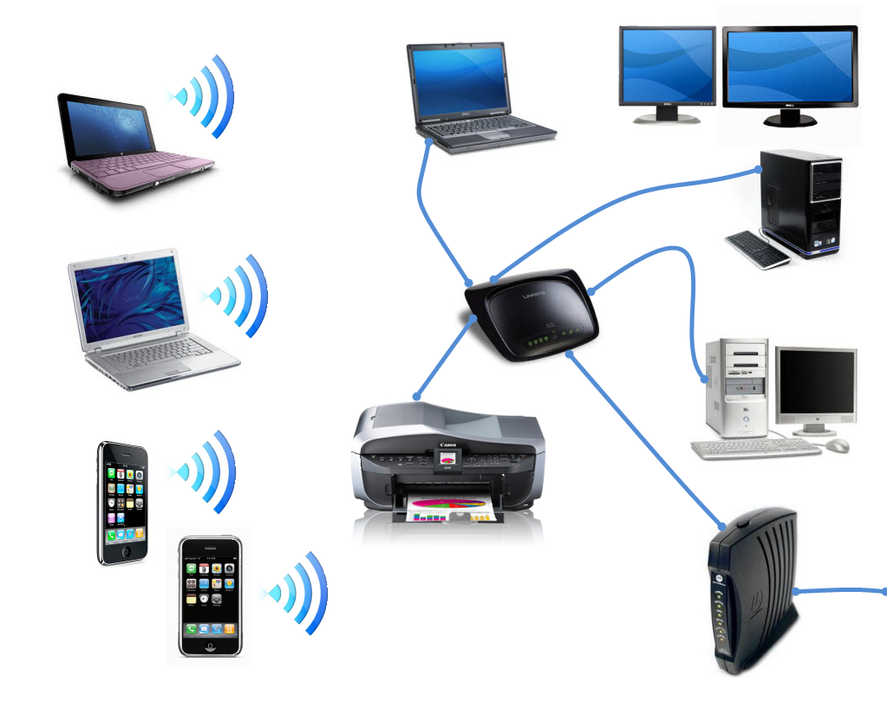
Typical Home Network

Slide 30
Service Set Identifier (SSID)
Identifies wireless network
Similar to workgroup name
All wireless network devices are configured with a default SSID (i.e., Linksys)
To secure the wireless network, the default SSID should be changed

Slide 31
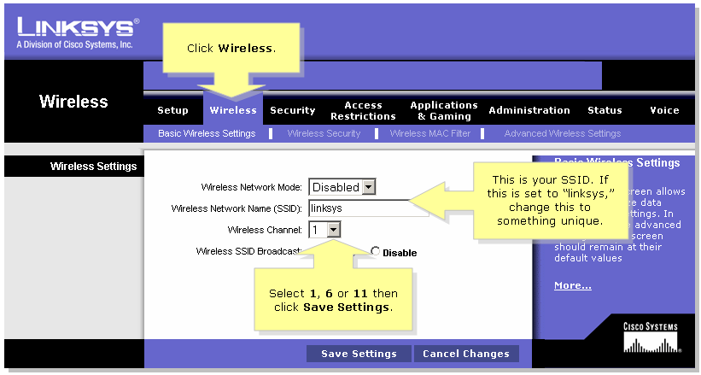
SSID

Slide 32
Media Access Control (MAC) Filtering
To configure MAC filtering, administrator creates an Access Control List (ACL)
ACL is located on Wireless Access Point (WAP)
ACL contains list of MAC addresses belonging to authorized wireless network devices

Slide 33
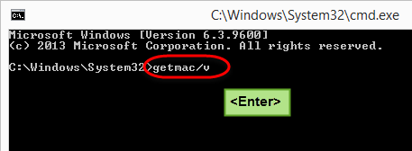
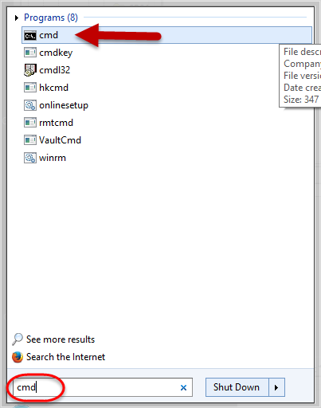
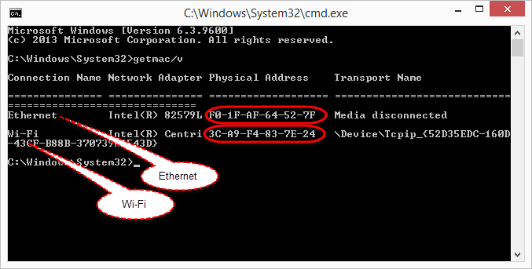
Find your MAC Address
3
2
4
1

Slide 34
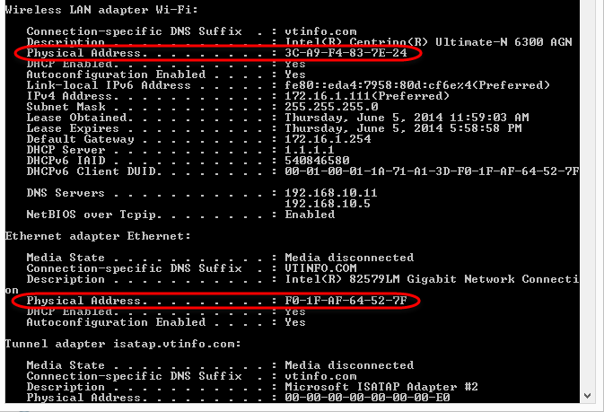
Also: ipconfig /all

Slide 35
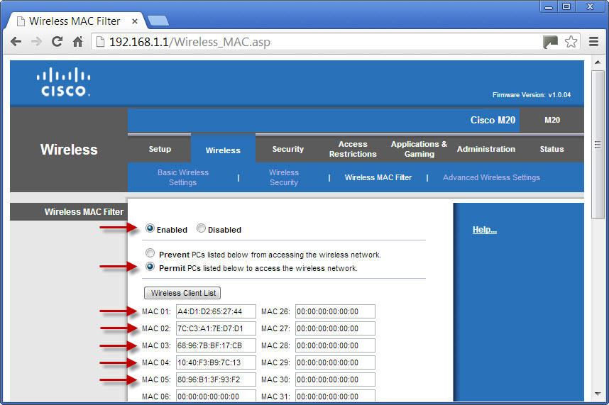
CISCO Router MAC Filter Setup

Slide 36
Wired Equivalent Privacy (WEP)
First attempt use encryption to secure the data transferred across a wireless network
Algorithm not complex and can be easily cracked
A VPN can add to the security set in place by WEP

Slide 37
Wi-Fi Protected Access (WPA)
Developed by the Wi-Fi organization to overcome the vulnerabilities of WEP
Compatible with 802.11 devices
Wi-Fi Protected Access 2 (WPA2) is an enhanced version of WPA
WPA2 is compatible with the 802.11i standard

Slide 38
How Networks Work
How TCP/IP Works

Slide 39
Protocol
Set of rules governing communication between devices on a network
Determines:
How devices identify each other
Method of data exchange
Size of each packet
Timing for packet transmission
Signal to be used to end a session

Slide 40


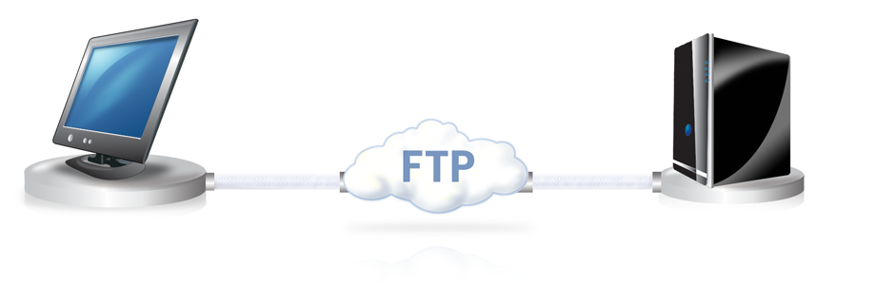
Protocols
TCP/IP (Transmission Control Protocol/Internet Protocol)—Provides Internet communication
HTTP (Hypertext Transfer Protocol)
FTP (File Transfer Protocol)—Used to transfer files from one host to another

Slide 41
TCP/IP
Suite of protocols that supports communication between network devices on a LAN and the Internet
All major operating systems
Use the TCP/IP protocol suite and IPv4 and IPv6 format
Each OS uses its own proprietary protocols to maintain backward compatibility with legacy OSs, and for file sharing and printer access

Slide 42
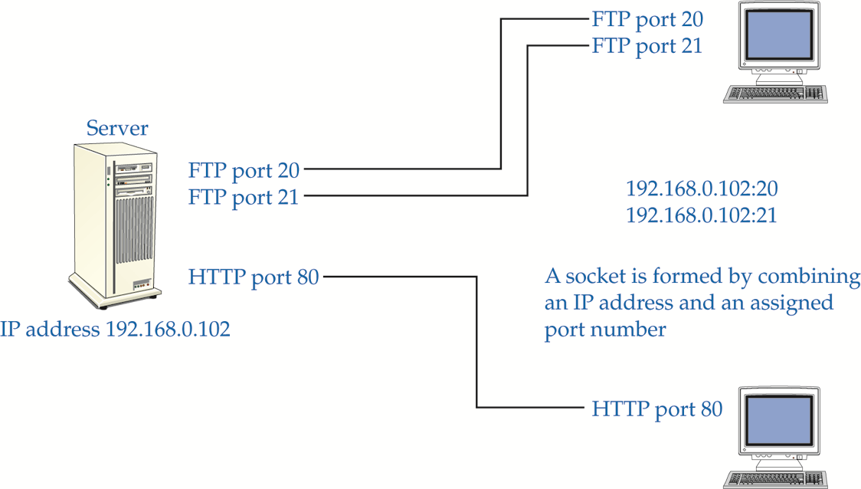
TCP/IP Ports and Socket
A port number combined with an IP address (socket) is used to create a virtual connection

Slide 43
Common Port Numbers
Service or Protocol | Port Number
FTP | 20, 21
SSH | 22
Telnet | 23
SMTP | 25
DNS | 53
TFTP | 69
HTTP | 80
POP3 | 110
NNTP | 119
NTP | 123
IMAP4 | 143
HTTPS | 443

Slide 44
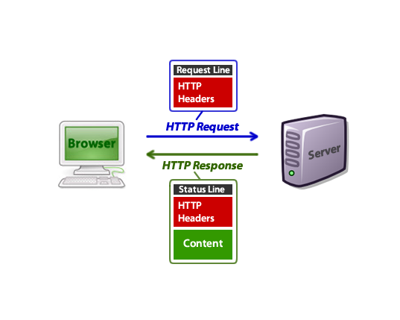
Hypertext Transfer Protocol (HTTP)

Slide 45
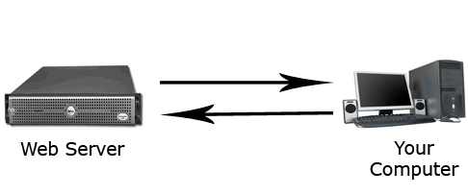
FTP
File Transfer Protocol (FTP)

Slide 46
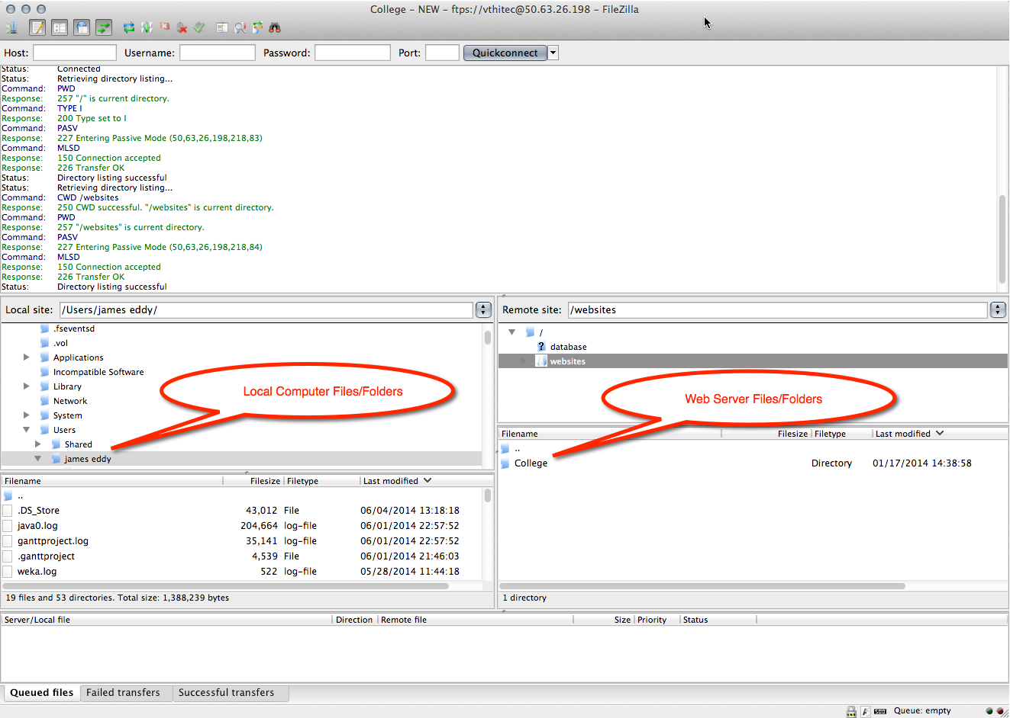
Transferring Files
FTP Client: FileZilla

Slide 47
How Networks Work
How Bridges, Routers, and Switches Work

Slide 48
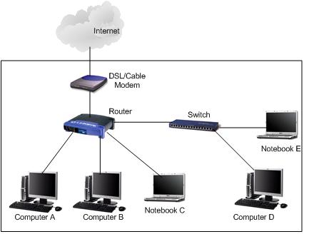
Basic Network Setup

Slide 49
Bridge
Forward data depending on the destination address in the data packet.
Address is the MAC address.
Used to connect two LANs.
Bridge is software based

Slide 50
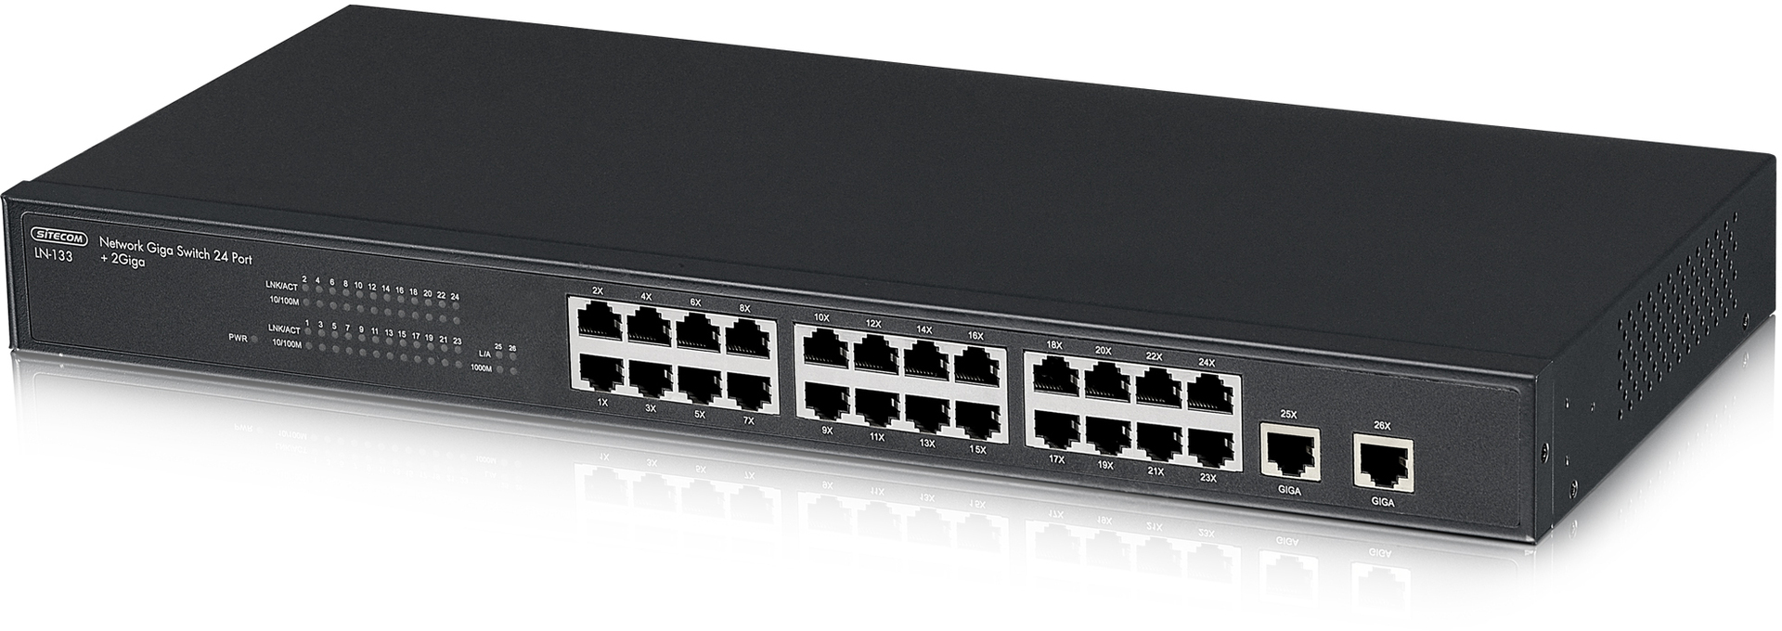
Switch
Similar to Bridges, but have multiple ports
Switch makes decision in hardware (internal main processer)
Designed to connect devices

Slide 51
Switch
A switch is used in a wired network to connect Ethernet cables from a number of devices together. The switch allows each device to talk to the others. Switches aren't used in networks with only wireless connections, since network devices such as routers and adapters communicate directly with one another, with nothing in between.
Although you can use the ports on the back of a router or modem to connect a few Ethernet devices together, depending on the model, switches have a number of advantages:
Switches allow dozens of devices to connect.
Switches keep traffic between two devices from getting in the way of your other devices using the same network.
Switches allow control of who has access to various parts of the network.
Switches allow you to monitor usage.
Switches allow communication (within your network) that's even faster than the Internet.
High-end switches have pluggable modules to tailor them to network needs.

Slide 52
Network Segmenting Devices
Physical devices can also be used to segment a network
Bridge and switch segment a network at the data link layer
A router segments the network at the network layer

Slide 53
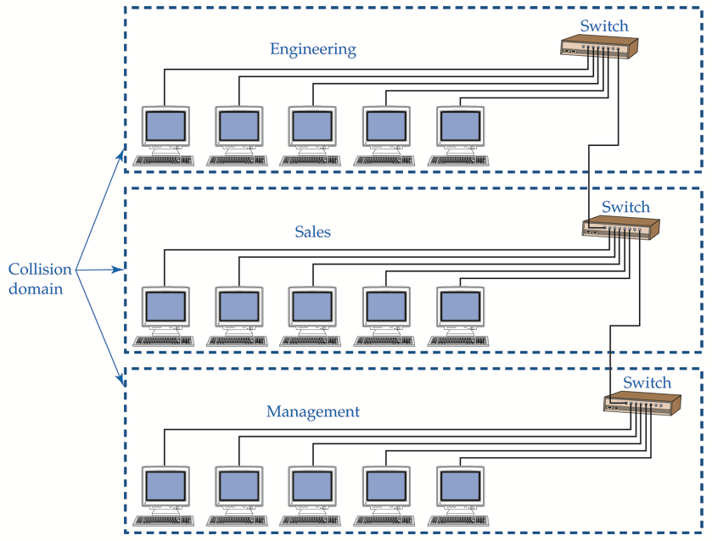
Segmenting with Switches or Routers

Slide 54
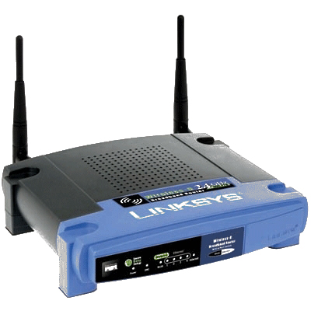
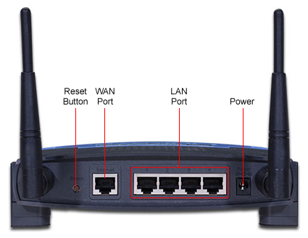
Wireless Router
Linksys WRT54GL Wireless-G Broadband Router

Slide 55
How Networks Work
How Internet Connections Work

Slide 56
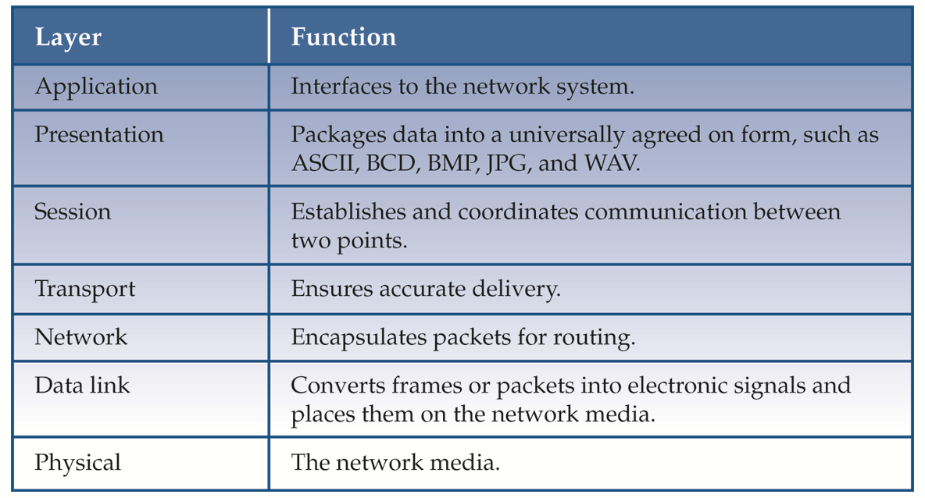
Open Systems Interconnection (OSI) Model

Slide 57
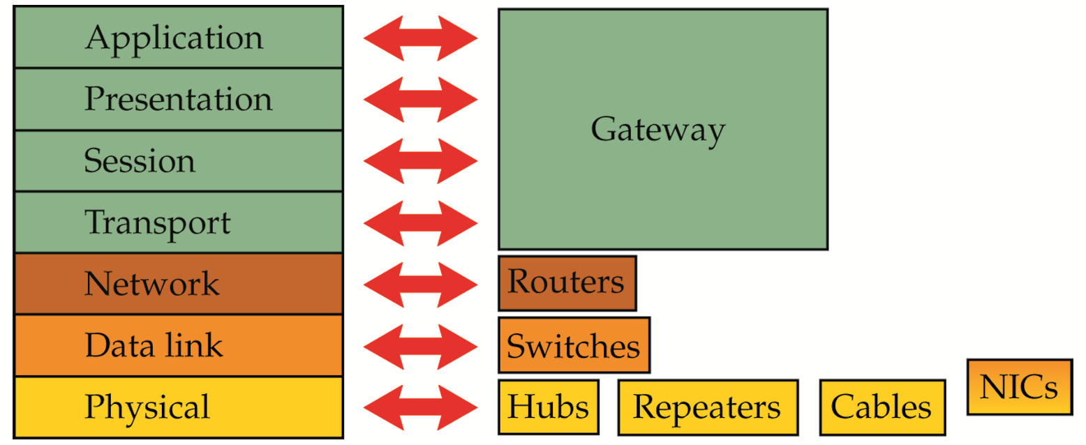
OSI Model

Slide 58
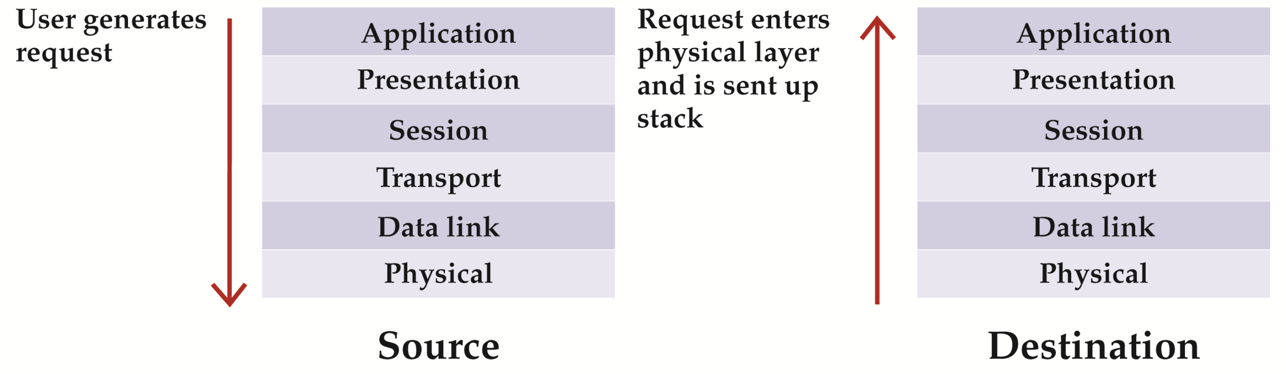
Application Layer
Where the user interfaces with network operating system
Start and final destination of data communication

Slide 59
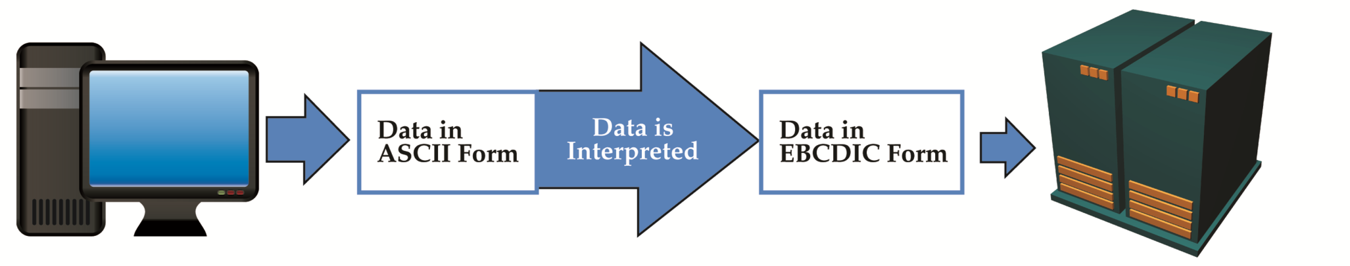
Presentation Layer
Raw data is packaged into a universally agreed on form
Data byte order is also agreed on
Data encryption occurs

Slide 60
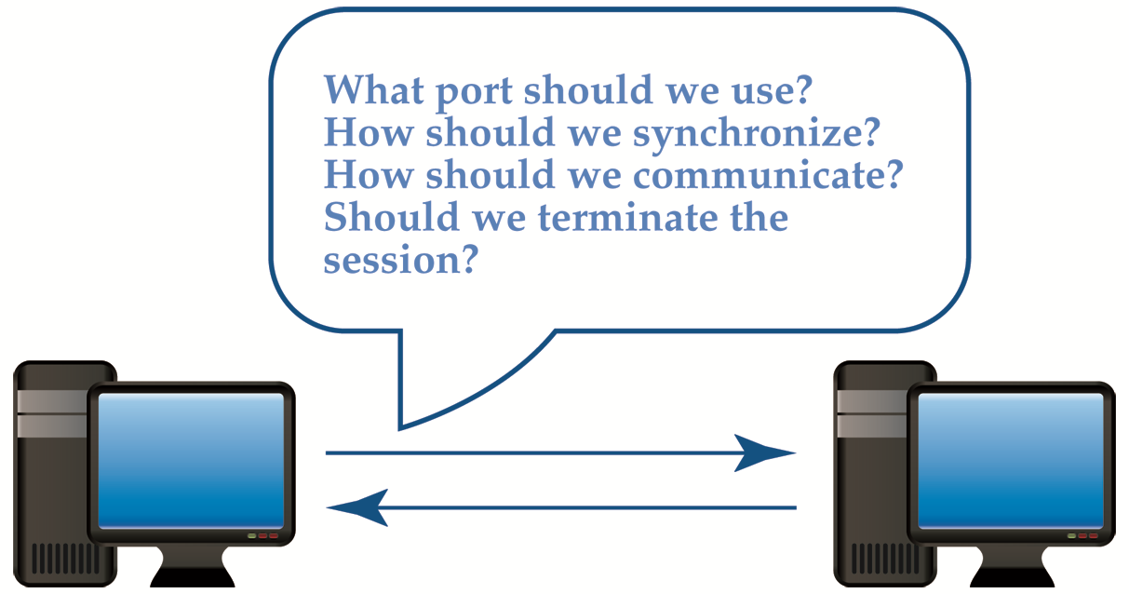
Session Layer
Establishes a dialog between source and destination
Negotiates decisions about how data flow is controlled and how session ends
Decides on whether confirmation of arrival is needed

Slide 61
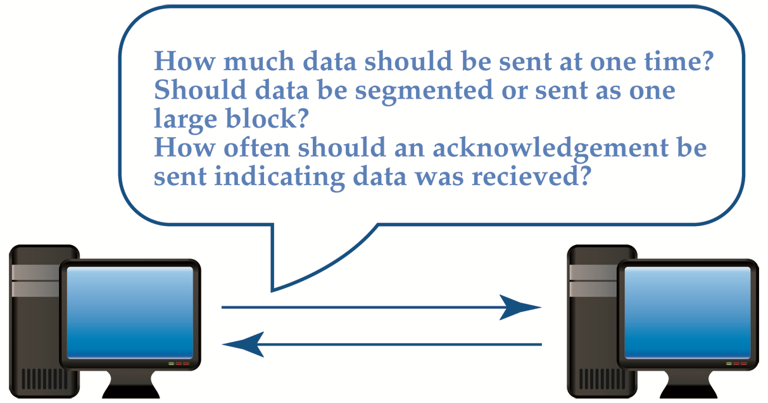
Transport Layer
Responsible for flow of data to and from destination computer

Slide 62
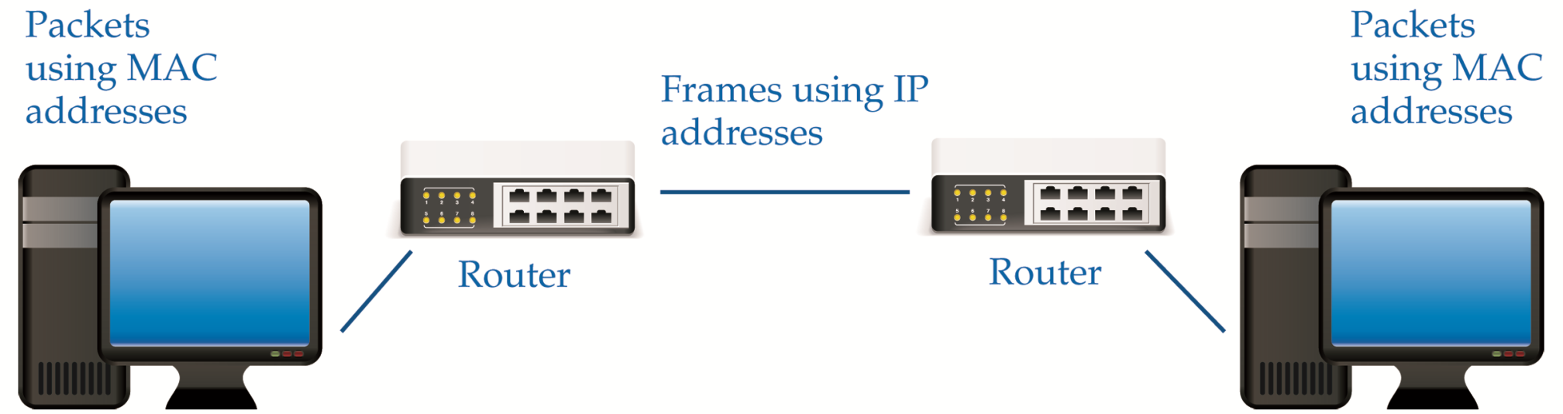
Network Layer
Provides the means of routing data packets across a WAN or MAN
Uses TCP/IP protocol standards
Encapsulates packets with source and destination IP addresses
Responsible for virtual networks

Slide 63
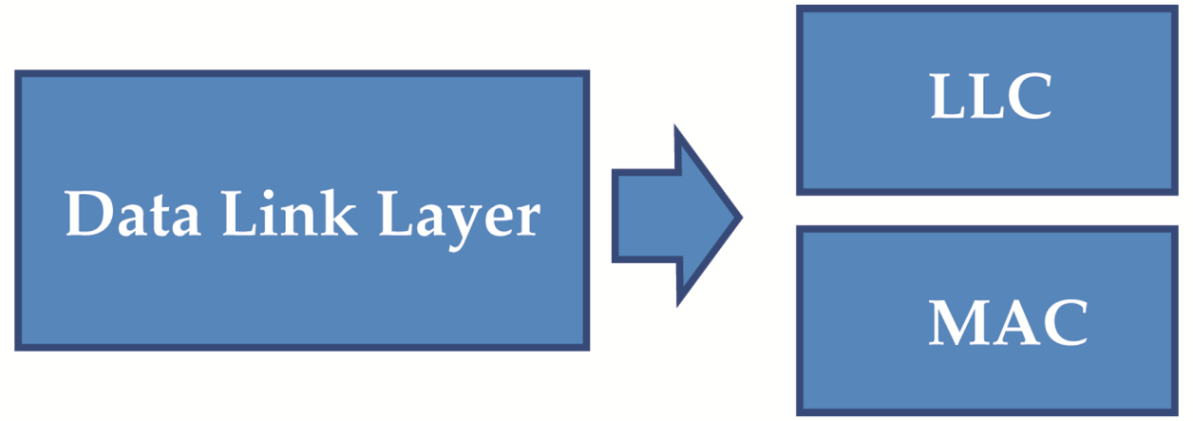
Data Link Layer
Converts data package into electrical pulses and places pulses on network media
Subdivided into logical link control (LLC) and MAC sublayer
Parity and Cyclic Redundancy Checks (CRC) performed

Slide 64
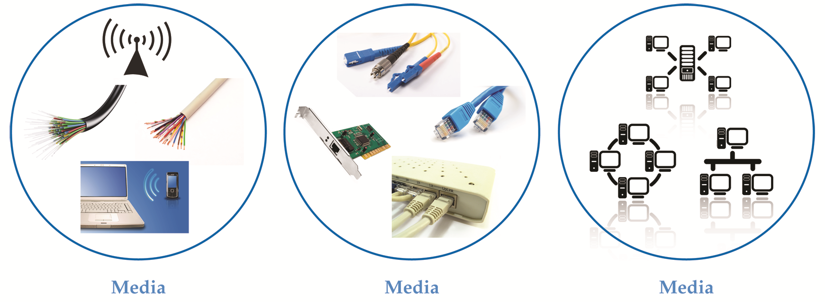
Physical Layer
Concerned with media, hardware, and network topology

Slide 65
OSI Model and Network Devices
Layer 3 Device
Makes decisions about where a packet is sent based on the Internet Protocol
Layer 2 Device
Makes decisions about where a packet is sent based on a MAC address or logical name
Layer 1 Device
Makes no decisions about where a packet is sent

Slide 66
How Networks Work
How Network Security Works

Slide 67
Network Security
Network security comprises authentication and encryption
Authentication is typically accomplished through a user name and password
Other forms of authentication are digital certificates, smart cards, and biometrics

Slide 68
Administrator Account
User provides password for default administrator account
Default administrator account name should be changed to better secure network
Ability to delete or rename the administrator account varies according to operating system

Slide 69
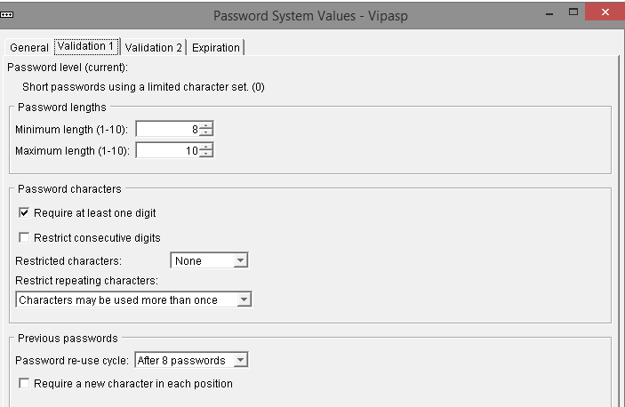
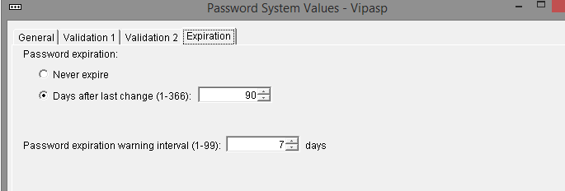
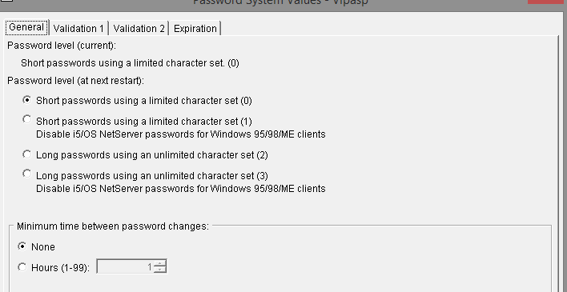
Setting Password Criteria (admin)

Slide 70
User Account Passwords
To make passwords more secure administrators should:
Set defaults for password histories, age, and length
Educate users about poor and secure passwords

Slide 71
Poor Passwords
Poor passwords contain:
Words that are found in a dictionary
Names familiar to the password owner
Keyboard patterns
Social security numbers
Secure passwords are less vulnerable to hashing techniques

Slide 72
Denial of Service (Dos)
One of the most common attacks on a server
Can overload a server to the point that it crashes or is not able to complete a legitimate user request

Slide 73
Trojan Horse
Example: Free download that contains malicious code
That code could contain virus, worm, or backdoor
Example: Can imitate legitimate logon screen
When user logs on, name and password are sent to unauthorized user

Slide 74
E-mail Attachments
Source of most commonly encountered viruses
Malicious code can be programmed into attachment
When recipient opens attachment, malicious program is activated

Slide 75
Social Engineering
Relies on the gullibility of a network user and his or her respect for authority

Slide 76

Phishing
E-mail can appear as if it’s from a legitimate company, such as a credit card company
E-mail requests user’s personal information, such as social security number or bank account PIN
Phony web sites that look authentic, but have slightly different domain names

Slide 77

Firewall
Can consist of hardware, software, or a combination
Servers, routers, and PCs may be used
Designed to filter inbound and outbound flow of network packets based on factors such as
IP address
Port number
Software application
Packet contents
Protocol

Slide 78
What is a Firewall?
A layer of security between your home network and the Internet. Since a router or modem is the main connection from a home network to the Internet, a firewall is often packaged with those devices.
Firewalls are a combination of hardware and software. The hardware part gives firewalls excellent performance, while the software part allows firewalls to be tailored to your specific needs.

Slide 79

Firewall Example

Slide 80
What is a Firewall?
Some applications outside a network require manually changing your firewall to allow them access. Examples of these applications include online games, VPN, and Voice-Over-IP.
A firewall does not secure against every kind of data and attack. (still need to run a virus-checker on all your computers.)
Other products such as Windows and macOS create software firewalls. These can cause network problems, because they are trying to apply different security to your network, which other firewalls will not accept. May need to disable conflicting firewalls.
Firewall features vary by model - newer and more expensive products have more advanced features. Firewall features are described in a product's datasheet, and their configuration information is found in the manuals.
The term firewall is often used to describe the part of a network that is protected by a firewall, as in the phrase behind the firewall. Parts of a network that are outside the firewall are more vulnerable to attack.

Slide 81
Network Address Translation (NAT)
Allows unregistered private network addresses to communicate with legally registered IP addresses
Advantages
Hides internal IP addresses, thus providing security
Eliminates need for multiple registered IP addresses
Allows multiple ISDN (Integrated Services for Digital Network) connections to be combined into one Internet connection

Slide 82
How Networks Work
Subnetting

Slide 83

Purpose of Subnetting

Slide 84
Advantages / Disadvantages
Advantages | Disadvantages
Creates a more secure network by placing hosts on separate networks | Can be difficult to manage
Reduces amount of collision on the network | Can be confusing because some equipment use subnets based on all one and all zero bit patterns

Slide 85


Slide 86
How Networks Work
VPN

Slide 87

Virtual Private Network (VPN)
Creates a private connection over the Internet or Intranet
VPN software and firewalls provide security
Four most common protocols used in a VPN are PPTP, L2F, L2TP, and IPSec

Slide 88
How Networks Work
Cloud Computing

Slide 89

Cloud Computing

Slide 90
How Networks Work
Network Troubleshooting

Slide 91

Troubleshooting Methodology

Slide 92
TCP/IP Troubleshooting Utilities
TCP/IP Utility | Function | When to Use
netstat | Displays current TCP/IP and port statistics | To determine network problems, monitor connections, and check for open ports
nbtstat | Displays NetBIOS over TCP statistics | To see a list of computers currently connected to the network
ping | Sends a packet from one host to another and then echoes a return reply | To quickly check the state of network media between two hosts
tracert or traceroute | Sends a packet from one host to another and gathers statistics and information along the way | To troubleshoot the path to a distant destination
arp | Maps the host MAC address to the host IP address | To verify IP address and MAC address assignments
nslookup | Resolves domain names to IP addresses | To find information about domain names and IP addresses

Slide 93



Networks
Dictionary: Network (n) - a system of interconnected computer systems, terminals, and other equipment allowing information to be exchanged
Can be as simple as two computers in one room or as large as thousands of computers all over the world

Slide 94
Pros and Cons
Advantages | Disadvantages
Share software, data, equipment, and communications quickly, easily, and inexpensively | Losing access to files Need additional personnel
Secure data | Vulnerability to hackers, viruses, and disgruntled workers

